Slide 1


THERMAL-CARBON-AWARE DYNAMIC SCHEDULING IN KUBERNETES FOR REDUCED GRID AND FACILITY-LEVEL EMISSIONS

Slide 2
PROBLEM STATEMENT
The rapid expansion of AI and LLM technologies is driving an unsustainable surge in data center electricity use—projected to jump from 200 TWh in 2022 to over 1000 TWh by 2030. This positions the tech industry as a primary contributor to global greenhouse gas emissions.
Existing "carbon-aware" solutions attempt to mitigate these emissions by shifting tasks to renewable energy zones, but they treat AI models rigidly and completely ignore the intense, localized thermal spikes these specific computations generate.
Routing heavy AI workloads without thermal awareness forces the destination data center’s cooling infrastructure to run at maximum capacity. This severe secondary energy drain completely cancels out any theoretical carbon reduction gained from the initial workload shift.

Slide 3
LITERATURE REVIEW
Paper 1 : Carbon emission-aware job scheduling for Kubernetes deployments
  Authors & Year: T. Piontek, K. Haghshenas, & M. Aiello (2023)
  Methodology Used:
    Developed a custom Kubernetes Scheduler Extender API.
    Utilized historical grid emission datasets (ElectricityMap) to predict future carbon intensity (gCO_2/kWh).
    Implemented temporal shifting of non-critical workloads to low-carbon time windows while ensuring zero Service Level Agreement (SLA) violations.
  Major Gaps & Limitations:
    Ignores Thermal Impact: Focused strictly on traditional, predictable web applications rather than high-performance AI workloads.
    Thermal Blind Spot: Explicitly lists the incorporation of internal thermal constraints directly into the workload placement algorithm as future scope—which is the primary gap your project addresses.

Slide 4
LITERATURE REVIEW
Paper 2: Kepler: A Framework to Calculate the Energy Consumption of Containerized Applications
  Authors & Year: M. Amaral et al. [IBM Research] (2023)
  Methodology Used:
    Uses Extended Berkeley Packet Filter (eBPF) routines inside the Linux kernel to hook into hardware performance counters (RAPL, ACPI).
    Applies machine learning regression models to calculate real-time, pod-level energy consumption and power draw without invasive code changes.
  Major Gaps & Limitations:
    Vendor Specificity & Lack of Scheduling Integration: Energy estimation models heavily rely on specific vendor hardware counters.
    No Active Control: Kepler acts purely as a passive monitoring system; it does not feed telemetry directly back into a Kubernetes scheduler to trigger dynamic placement or thermal mitigation.

Slide 5
LITERATURE REVIEW
Paper 3: CarbonEdge: Carbon-Aware Deep Learning Inference Framework for Sustainable Edge Computing
  Authors & Year: Guilin Zhang, Wulan Guo, Ziqi Tan, Hailong Jiang (2026)
  Methodology Used:
    Created an algorithm that extends standard Kubernetes/edge latency scoring with a dedicated carbon efficiency metric.
    Dynamically lowers the precision (quantizes) deep learning inference models (e.g., MobileNet, EfficientNet) during periods of high grid carbon intensity to reduce device computational load.
  Major Gaps & Limitations:
    Accuracy Degradation & Thermal Disregard: Dynamic quantization inherently degrades model prediction accuracy, lacking dynamic safeguard thresholds for latency-critical or mission-critical AI tasks.
    No Thermal Feedback: It evaluates external grid carbon intensity but ignores internal chip temperature and heat spikes on the host device.

Slide 6
LITERATURE REVIEW
Paper 4: AI-Powered Data Center Power Monitoring: Architectures, Algorithms, and Operational Intelligence
  Authors & Year: Ishak H.A. Meddah (2026)
  Methodology Used:
    Synthesizes time-series ML models (LSTM, CNN, Transformers) with anomaly detection algorithms (Local Outlier Factor, ECOD) on high-dimensional power and temperature sensor telemetry.
    Leverages Reinforcement Learning (RL) to dynamically adjust data center Computer Room Air Conditioning (CRAC) cooling setpoints.
  Major Gaps & Limitations:
    Facility-Level vs. Scheduler-Level Isolation: Operates at the infrastructure cooling level rather than addressing the problem at the container orchestration (Kubernetes pod) layer.
    Lack of Explainability: High computational complexity makes real-time, lightweight deployment on resource-constrained edge hardware difficult.

Slide 7
LITERATURE REVIEW
Paper 5: Cost-Effective Kubernetes at the Edge: A Comparative Analysis of K3s on Raspberry Pi versus Cloud Deployments
  Authors & Year: S. R. Sankiti et al. (2025)
  Methodology Used:
    Deployed and benchmarked K3s across a physical cluster of Raspberry Pi 5 single-board computers.
    Integrated a full cloud-native observability stack (Prometheus, Grafana, Loki) to measure real-time node performance and resource usage against cloud environments.
  Major Gaps & Limitations:
    Thermal Throttling Bottleneck: Highlights that resource-constrained edge clusters suffer heavily from thermal throttling under sustained compute loads.
    Passive Observation: The paper only evaluates performance; it does not implement an active, thermal-aware orchestrator to prevent nodes from hitting thermal limits.

Slide 8
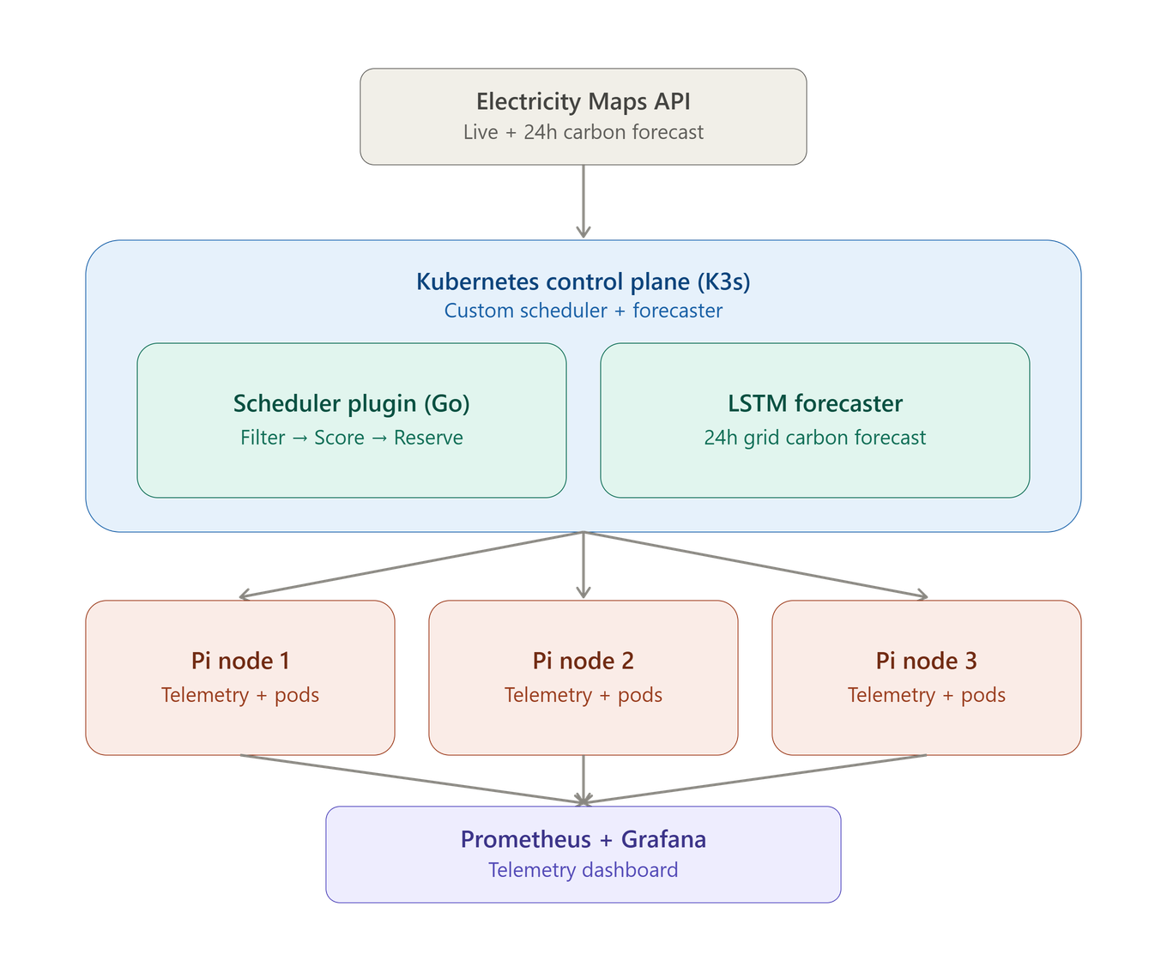
PROPOSED WORK

Slide 9
PROPOSED WORK
  Spatio-Temporal-Thermal Orchestrator: A custom Kubernetes scheduling plugin that jointly evaluates two signals before placing an AI workload: the external grid's carbon intensity and the internal node's real thermal/power state. Unlike prior carbon-aware schedulers (which are grid-blind to hardware heat) or thermal-aware schedulers (which ignore the grid entirely), this is the first to unify both inside the Kubernetes Scheduling Framework itself, validated on physical hardware rather than simulation.
  External Grid Carbon Forecasting: A containerized Python LSTM trained on historical grid time-series data, predicting regional carbon intensity 24 hours ahead. Live signal ingestion uses the Electricity Maps API (academic-tier access via institutional email for full historical/forecast data); where regional coverage is thin, Ember and POSOCO/CEA generation data serve as the ground-truth validation source.
  Internal Node-Level Metrics: Rather than Kepler — which depends on Intel RAPL/ACPI counters that don't exist on ARM — thermal and power data is read directly from each Pi's own interfaces:
    vcgencmd measure_temp for temperature (all models)
    vcgencmd pmic_read_adc for real per-rail voltage/current on Pi 5 (giving true watts via P=V×I with no extra hardware). Where Pi 4 boards are used, an inline INA219 I²C sensor provides the same power data. A lightweight custom exporter pushes this to Prometheus.

Slide 10
  Dynamic AI Precision Scaling (Quantization): A runtime payload adjuster for latency-sensitive jobs that can't be paused or migrated. When a node's thermal or carbon state crosses an unsafe threshold, the model is dropped to lower precision instead of blocking the task — but with an explicit criticality/accuracy-floor gate that refuses to quantize below a set threshold for mission-critical inference.
  Physical Edge-Computing Validation: Tested on a real 3-node Raspberry Pi K3s cluster — not CloudSim or another simulator — proving the scheduler's own overhead doesn't cancel out the energy it saves.
  Open-Source Kubernetes Plugin Architecture: Go-based plugin, Apache 2.0, packaged with Helm chart + YAML manifests for any CNCF-conformant cluster.
  Live Green Observability Dashboard: Prometheus + Grafana, visualizing carbon reduction, thermal deviation, and net energy balance in real time.

Slide 11
METHODOLOGY
1: Building the Physical Edge Micro-Cloud
Before writing the scheduling logic, we need a physical environment that actually generates heat and represents a real-world edge computing scenario.
  Setting up a 3-node cluster of single-board computers. You will install a lightweight version of Kubernetes designed specifically for edge devices to manage your containers.
  The Tech Stack:
    Hardware: 3x Raspberry Pi (Model 4 or 5).
    OS: Ubuntu Server (or Raspberry Pi OS).
    Container Orchestration: K3s (Lightweight Kubernetes by Rancher).
2: External Grid Carbon Forecasting (The "Spatio-Temporal" Part)
Our system needs to know when and where the electricity grid is running on clean energy (like solar) versus dirty energy (like coal).
  We will train a time-series machine learning model to predict the grid's carbon intensity 24 hours into the future. This model will be wrapped in a container and run continuously, pulling live data from the internet.
  The Tech Stack:
    Programming Language: Python.
    Machine Learning Model: LSTM (Long Short-Term Memory) network.
    External Data APIs: ElectricityMap.
    Historical Dataset: Ember's India Electricity Data Explorer dataset.

Slide 12
3: Internal Heat & Power Metrics (The "Thermal" Part)
To prevent your Raspberry Pis from overheating, the system needs to constantly monitor the exact temperature and power draw of the chips without slowing the computer down.
  We will read hardware sensors directly through the Pi's own built-in interfaces.
  The Tech Stack:
    Temperature: vcgencmd measure_temp (built into all Raspberry Pi models, no extra hardware needed)
    Power: vcgencmd pmic_read_adc on Raspberry Pi 5 (reads real per-rail voltage and current directly from the onboard PMIC, giving true watts with no extra parts); an INA219 I²C sensor (~$5–10 per node) as the Raspberry Pi 4 fallback, since Pi 4 doesn't expose the same PMIC data
    Exporter: a custom lightweight Go or Python script that reads these values and pushes them to Prometheus.
4: The Custom Orchestrator Plugin (The Brain)
This is the core software of your project. It acts as the traffic controller that looks at both the external grid forecast and the internal heat telemetry before assigning an AI task.
  We are writing a custom scoring algorithm that plugs directly into the standard Kubernetes scheduler. When a user requests to run an AI model, this algorithm scores all three Raspberry Pis. It finds the node that has the lowest carbon footprint and the coolest physical temperature, and binds the task to that specific node.
  The Tech Stack:
    Programming Language: Go (Golang).
    Framework: Kubernetes Scheduling Framework (Scheduler Extender/Plugin).
    Deployment Tools: YAML manifests and Helm charts.

Slide 13
5: Dynamic AI Precision Scaling (The Safety Valve)
If an AI task is extremely urgent, but all nodes are running hot or the grid is heavily polluting, the system needs a backup plan.
  We will write a software driver that acts as a runtime adjuster. If it detects unsafe heat or high carbon levels, it automatically "quantizes" the AI model. This means it drops the AI's precision (e.g., from 32-bit floating point to 8-bit integers), which drastically reduces the computing power and heat generated, allowing the task to finish safely.
  The Tech Stack:
    Scripting: Python.
    AI Frameworks: PyTorch or ONNX (for handling model quantization)
6: Green Observability (The Live Monitor)
We need to visually prove that your system is saving energy and keeping the hardware cool.
  We will set up a data collection pipeline that gathers all the metrics from Kepler and your custom scheduler, and then displays them on a live, interactive web dashboard.
  The Tech Stack:
    Metrics Aggregation: Prometheus.
    Visual Dashboard: Grafana.

Slide 14
THE END
Aakhil Subair - AM.SC.U4AIE23101
Jaydeep Dileep - AM.SC.U4AIE23114
KR Karthik - AM.SC.U4AIE23116

